Slide 1
CSS TAGS AND THEIR DEFINATION
Name : Pradeep Singh
Enrollment No. :- 2404030400169
Branch : BSc CS IT
Division : A

Slide 2
CSS (Cascading Style Sheets)
It is a stylesheet language used to style and enhance website presentation.
CSS is one of the main three components of a webpage along with HTML and JavaScript.
HTML adds Structure to a Webpage, JavaScript adds logic to it and CSS makes it visually visually appealing or stylish. It controls the layout of a web page i.e. how HTML elements will be displayed on a web page
CSS describes how HTML elements should be displayed.
CSS is the language we use to style an HTML document.

Slide 3
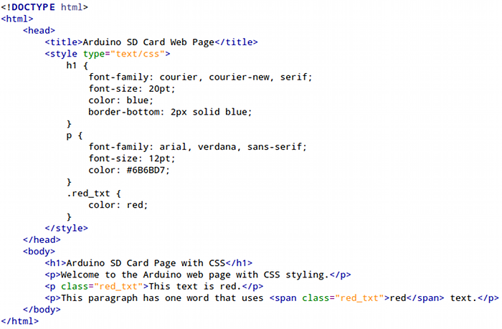
CSS Page Structure

Slide 4
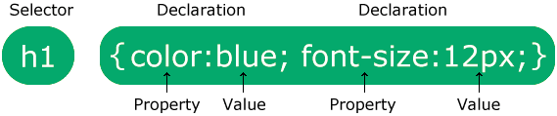
CSS Syntax
The selector points to the HTML element you want to style.
The declaration block contains one or more declarations separated by semicolons.
Each declaration includes a CSS property name and a value, separated by a colon.
Multiple CSS declarations are separated with semicolons, and declaration blocks are surrounded by curly braces.

Slide 5
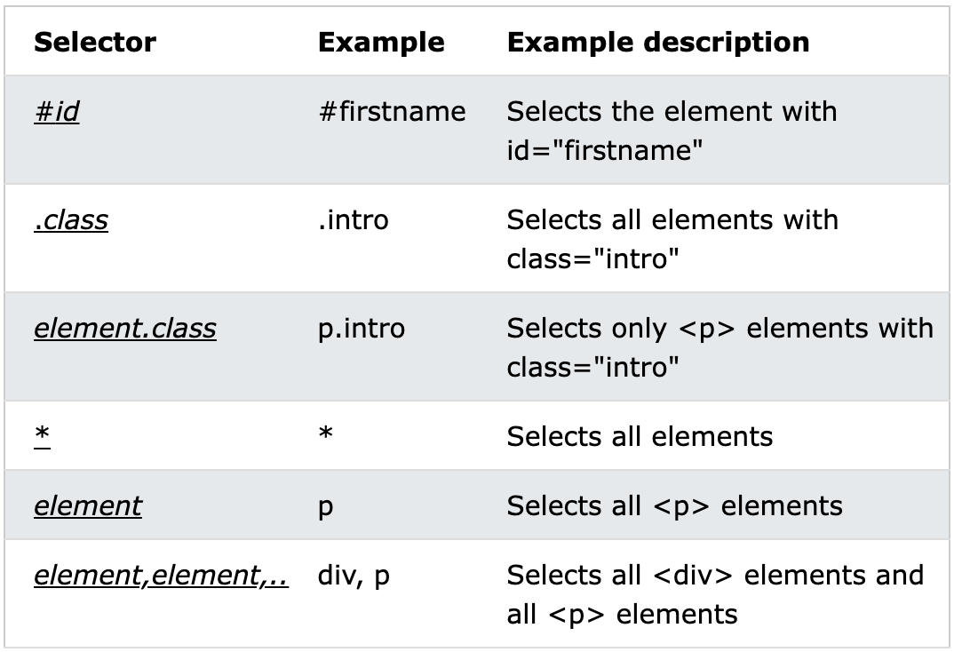
CSS Selectors
CSS selectors are used to "find" (or select) the HTML elements you want to style.
We can divide CSS selectors into five categories:
Simple selectors (select elements based on name, id, class)
Combinator selectors (select elements based on a specific relationship between them)
Pseudo-class selectors (select elements based on a certain state)
Pseudo-elements selectors (select and style a part of an element)
Attribute selectors (select elements based on an attribute or attribute value)

Slide 6
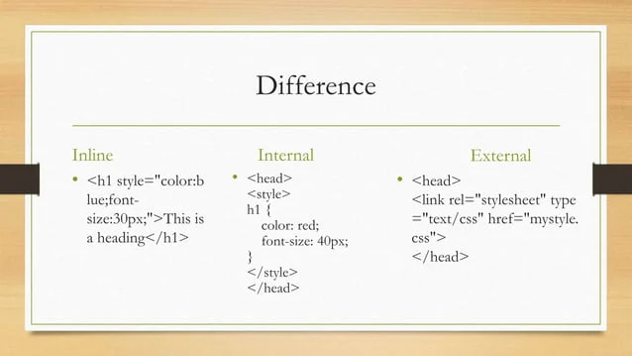
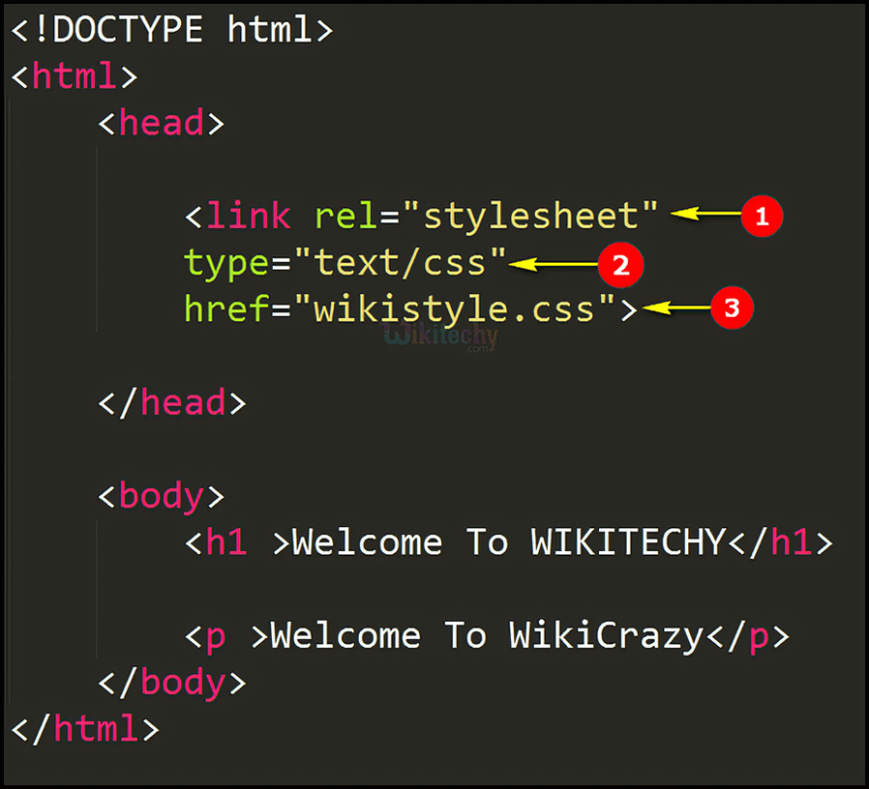
Ways to Insert CSS
There are three ways of inserting a style sheet:
External CSS
Internal CSS
Inline CSS
1. External CSS
External styles are defined within the <link> element, inside the <head> section of an HTML page:
To link an external CSS file to an HTML document, you need to use the <link> element within the <head> section of your HTML file.
The <link> element should have the rel attribute set to “stylesheet” and the href attribute specifying the path to your CSS file.

Slide 7
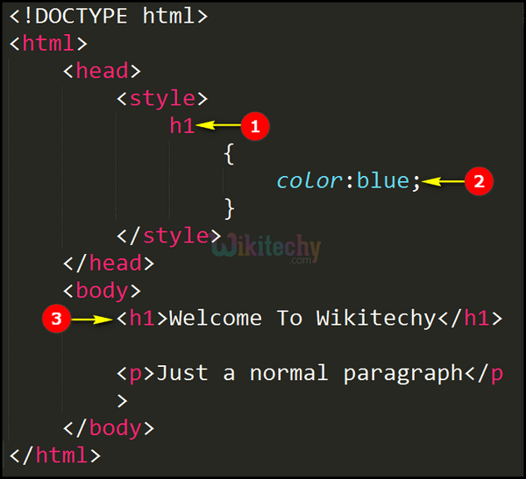
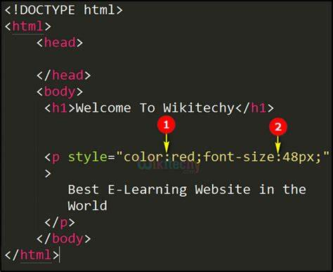
2. Internal CSS
Internal CSS is a method for defining CSS styles directly within an HTML document.
It’s particularly useful for applying unique styles to a single web page, and it’s embedded within the <style> element located in the <head> section of the HTML file.
3. Inline CSS
Inline CSS is a method that applies CSS styling directly to HTML elements using the ‘style’ attribute.
This approach allows developers to define styles for individual elements, making it an effective tool for applying unique styles to specific HTML elements.

Slide 8
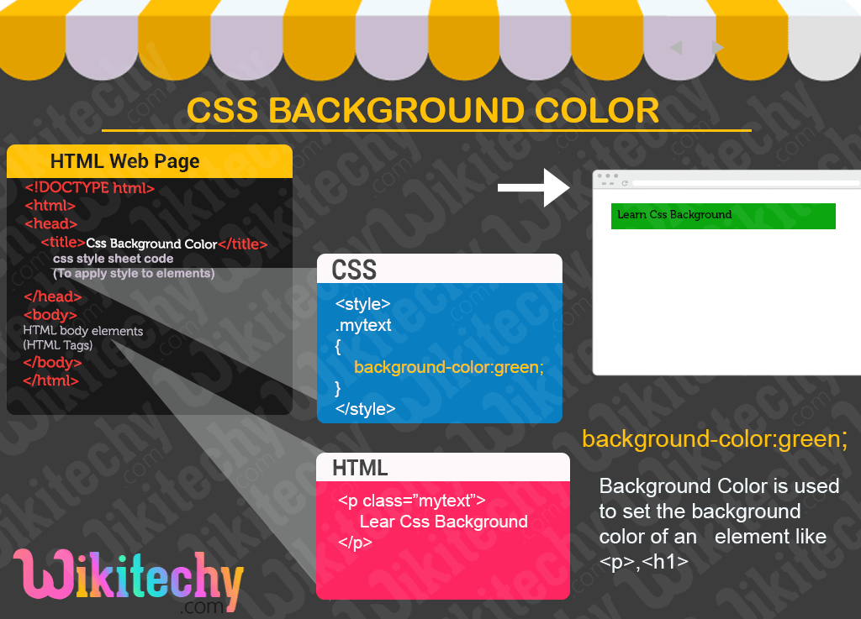
CSS COLORS
1. CSS Background Color
You can set the background color for HTML elements.
The CSS background is the area behind an element’s content, which can be a color, image, or both. The background property lets you control these aspects, including color, image, position, and repetition.

Slide 9
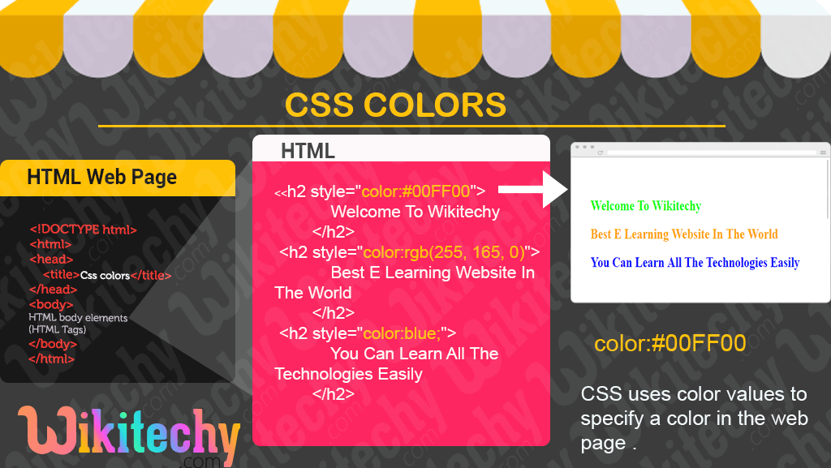
2. CSS Text Color
Sets the color of the text using color name, hex value, or RGB value.
The color property is used to apply color to the text. It’s important to ensure good contrast between the text and the background for readability.

Slide 10
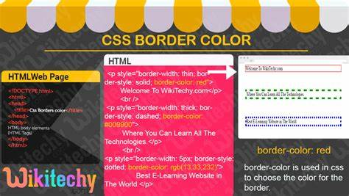
3. CSS Border Color
Borders in CSS are used to create a visible outline around an element. They can be customized in terms of
Width: The thickness of the border.
Style: The appearance of the border (solid, dashed, dotted, etc.).
Color: The color of the border.

Slide 11
THANKYOU

